Slide 1
Intro to R, part 3
EEOB590A
Haldre Rogers
Fall 2021

Slide 2
Announcements/Outline
Syllabus updated
R for Data Science
Help files
GitHub
In-class coding exercise

Slide 3
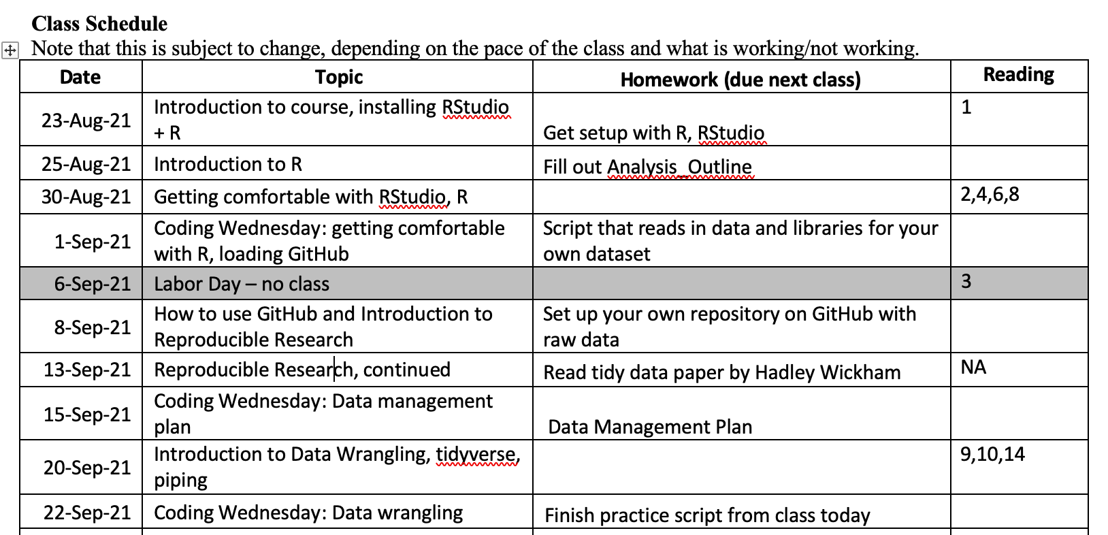
1. Syllabus changes

Slide 4
2. R for Data Science
https://r4ds.had.co.nz/explore-intro.html

Slide 5
3. Ways to get help
Can copy from help file to console and run to see how a function works
Data import cheat sheet in Intro to R → Resources
Can copy code from Data Science in R and run in console too

Slide 6
4. GitHub
Load Git and link GitHub to Rstudio/R
Create a repository to test whether this works

Slide 7
5. In-class coding exercise
Do R exercise Part 3 (sent to you on email)
If this is easy and you finish quickly, use the R CheatSheet to figure out how to load data from a google spreadsheet

Slide 8
Dealing with classes - Dates
Class "POSIXct" represents the (signed) number of seconds since the beginning of 1970 (in the UTC time zone) as a numeric vector.
ISO8601 – international standard with components organized biggest to smallest (year, month, day, hour, min, sec)
Lubridate package (tidyverse but not part of core installation)
Use functions like ‘ymd’, ‘dmy’,

Slide 9
Exploring dataframes
str(dataframe) - column classes and dimensions
head(dataframe) and tail() - first and last 6 rows
names(dataframe) - column names
row.names(dataframe) - row names
attributes(dataframe) - column and row names and object class
summary(dataframe) – gives a lot of good information
Make sure variables are appropriate class
Character/string, Numeric, Factor, Integer, logical
Make sure mins, maxs, means, etc. seem right
Make sure you don’t have typing errors so Premna and premna are two separate factors
Use: unique(spider$species) to see what all unique values of a column are
Or use: levels(spider$species) to see different levels
Notes:
Some numbers are actually factors- think of 0/1 for dead/alive or zipcodes (average zipcode?)

